Slide 1
3.0 Algorithms
Algorithm
Pseudocode
Computer Program
Flow Chart

Slide 2
3.0 Algorithms
The term algorithm is a corruption of the name al-Khowarizmi, a mathematician of the ninth century, whose book on Hindu numerals is the basis of modern decimal notation. Originally, the word algorism was used for the rules for performing arithmetic using decimal notation.
An algorithm is a finite sequence of precise instructions for performing a computation or for solving a problem.
Describe an algorithm for finding the maximum (largest) value in a finite sequence of integers.
Solution of Example
1: We perform the following steps. 1. Set the temporary maximum equal to the first integer in the sequence. (The temporary maximum will be the largest integer examined at any stage of the procedure.)
2. Compare the next integer in the sequence to the temporary maximum, and if it is larger than the temporary maximum, set the temporary maximum equal to this integer.
3. Repeat the previous step if there are more integers in the sequence.
4. Stop when there are no integers left in the sequence. The temporary maximum at this point is the largest integer in the sequence.

Slide 3
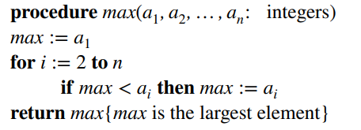
PROPERTIES OF ALGORITHMS
There are several properties that algorithms generally share. They are useful to keep in mind when algorithms are described. These properties are:
▶ Input. An algorithm has input values from a specified set.
▶ Output. From each set of input values an algorithm produces output values from a specified set. The output values are the solution to the problem.
▶ Definiteness. The steps of an algorithm must be defined precisely.
▶ Correctness. An algorithm should produce the correct output values for each set of input values.
▶ Finiteness. An algorithm should produce the desired output after a finite (but perhaps large) number of steps for any input in the set.
▶ Effectiveness. It must be possible to perform each step of an algorithm exactly and in a finite amount of time.

Slide 4
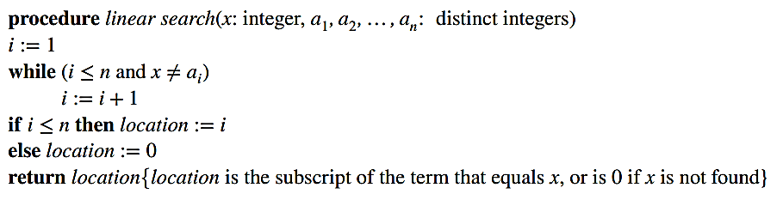
3.1 Searching Algorithms
The problem of locating an element in an ordered list occurs in many contexts. For instance, a program that checks the spelling of words searches for them in a dictionary, which is just an ordered list of words. Problems of this kind are called searching problems.
linear search, Links or sequential search

Slide 5
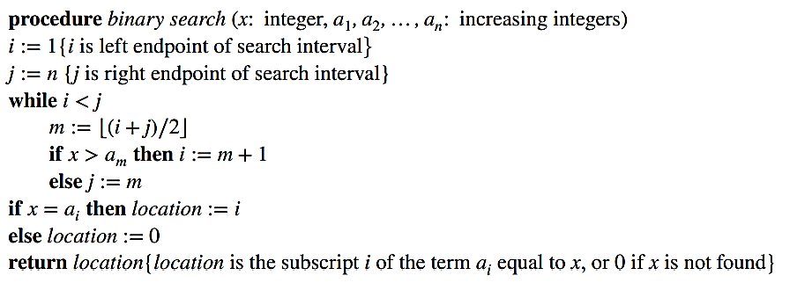
3.1 Searching Algorithms
Binary Search

Slide 6
3.1 Searching Algorithms, Example

Slide 7
3.1.3 Sorting
Ordering the elements of a list is a problem that occurs in many contexts. For example, to Demo produce a telephone directory it is necessary to alphabetize the names of subscribers. Similarly, producing a directory of songs available for downloading requires that their titles be put in alphabetic order. Putting addresses in order in an e-mail mailing list can determine whether there are duplicated addresses. Creating a useful dictionary requires that words be put in alphabetical order. Similarly, generating a parts list requires that we order them according to increasing part number.

Slide 8
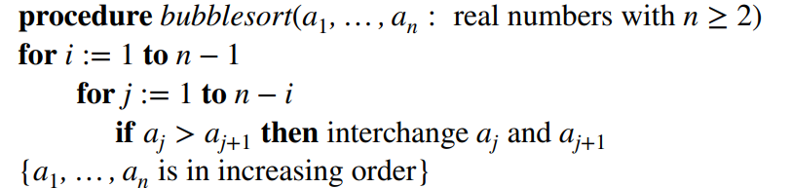
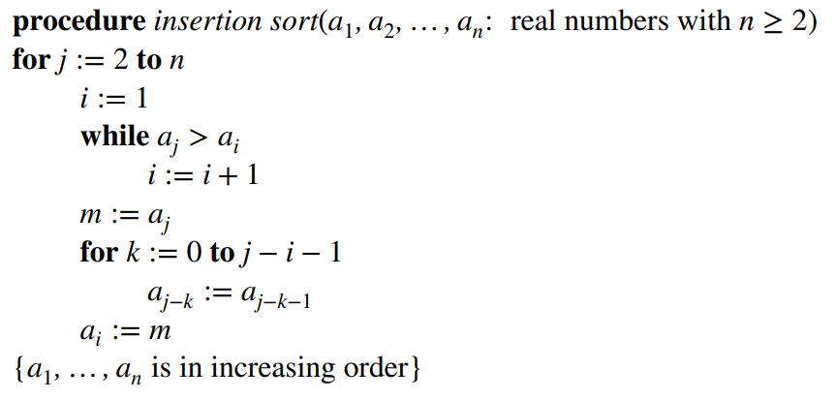
Bubble Sort
Insertion Sort

Slide 9
Bubble Sort, Example

Slide 10
Insertion Sort, Example

Slide 11
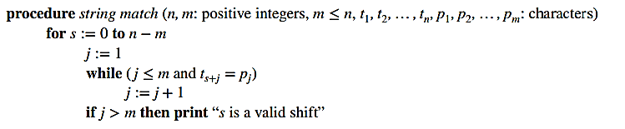
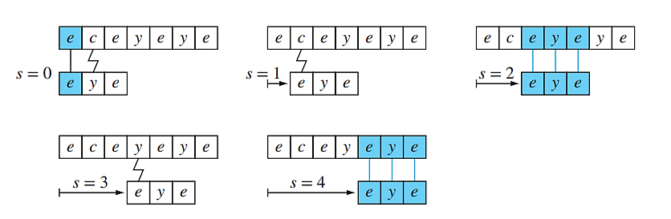
ALGORITHM, Naive String Matcher.
The steps of the naive string matcher with P = eye in T = eceyeye. Matches are identified with a solid line and mismatches with a jagged line. The algorithm finds two valid shifts, s = 2 and s = 4.

Slide 12
Greedy Algorithms
Many algorithms we will study in this book are designed to solve optimization problems. The goal of such problems is to find a solution to the given problem that either minimizes or maximizes the value of some parameter. Optimization problems studied later in this text include finding a route between two cities with least total mileage, determining a way to encode messages using the fewest bits possible, and finding a set of fiber links between network nodes using the least amount of fiber.
Cashier’s Algorithm
100 Cent = 1$
25 Cent = 1 Quarters
10 Cent = Dime
5 Cent = Nickels
1 Cent = Penny

Slide 13
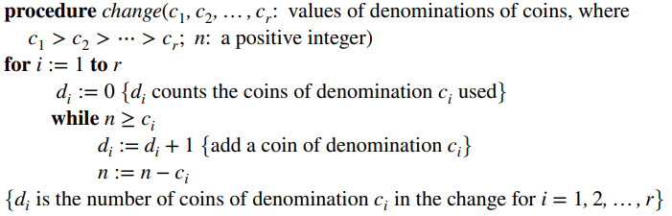
Greedy Algorithms
cashier’s algorithm

Slide 14
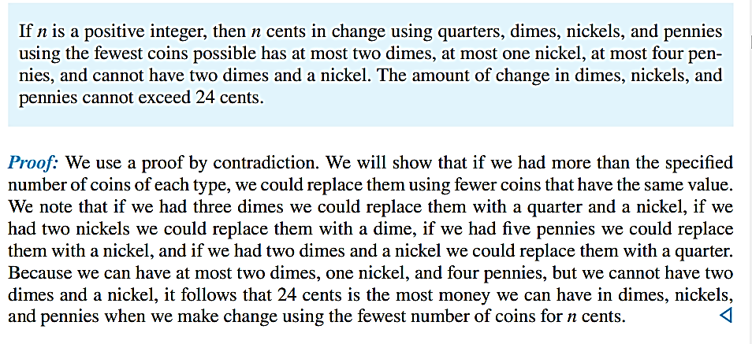
Greedy Algorithms

Slide 15
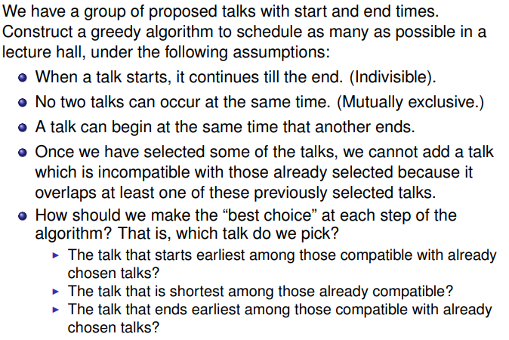
Greedy Algorithm for Scheduling Talks.

Slide 16
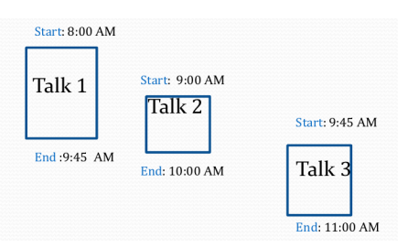
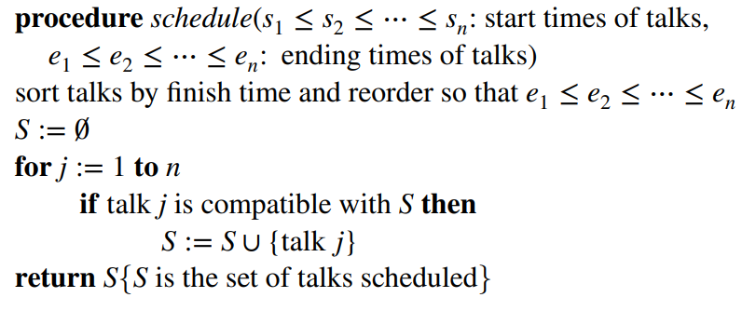
Greedy Algorithm for Scheduling Talks.

Slide 17
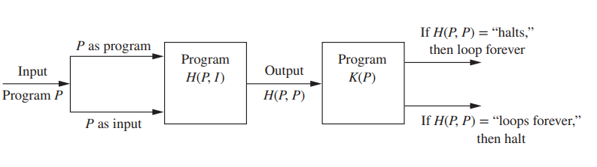
3.1.6 The Halting Problem
We will now describe a proof of one of the most famous theorems in computer science. We will show that there is a problem that cannot be solved using any procedure. That is, we will Links show there are unsolvable problems. The problem we will study is the halting problem. It asks whether there is a procedure that does this: It takes as input a computer program and input to the program and determines whether the program will eventually stop when run with this input. It would be convenient to have such a procedure, if it existed. Certainly being able to test whether a program entered into an infinite loop would be helpful when writing and debugging programs.

Slide 18
Halting means that the program on certain input will accept it and halt or reject it and halt and it would never go into an infinite loop. Basically halting means terminating. So can we have an algorithm that will tell that the given program will halt or not. In terms of Turing machine, will it terminate when run on some machine with some particular given input string.

Slide 19
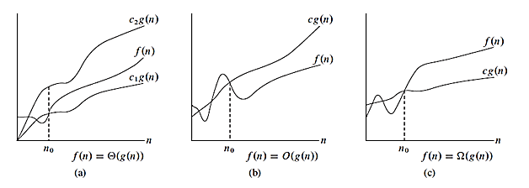
3.2 The Growth of Functions, Asymptotic Notations
Big O Omega Ω Theta θ

Slide 20
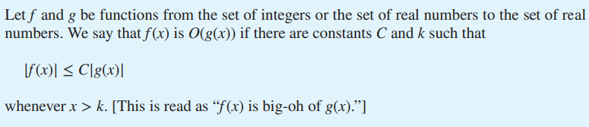
3.2 The Growth of Functions
WORKING WITH THE DEFINITION OF BIG-O NOTATION
A useful approach for finding a pair of witnesses is to first select a value of k for which the size of |f(x)| can be readily estimated when x > k and to see whether we can use this estimate to find a value of C for which
|f(x)| ≤ C|g(x)| for x > k.

Slide 21
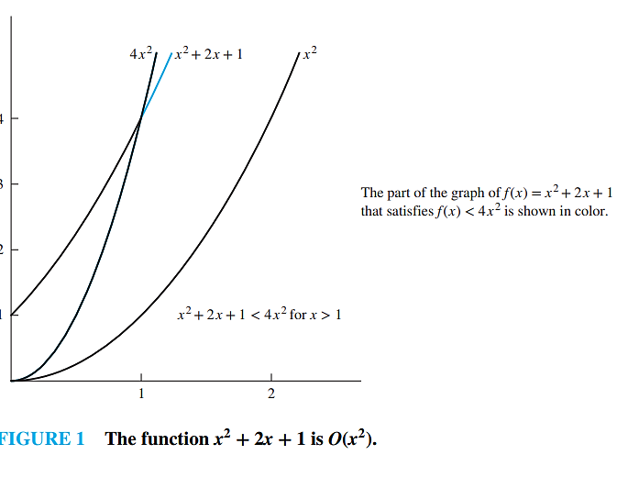
3.2 The Growth of Functions

Slide 22
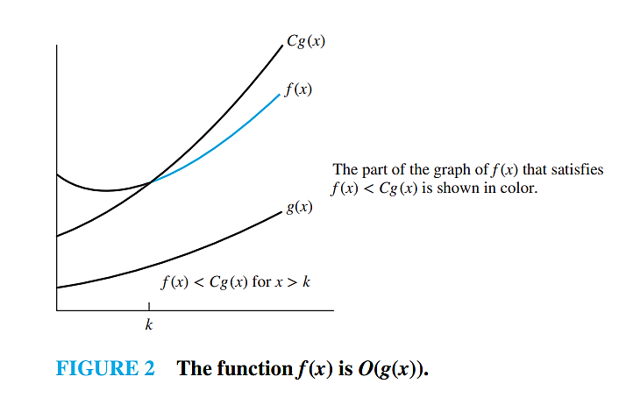
3.2 The Growth of Functions

Slide 23
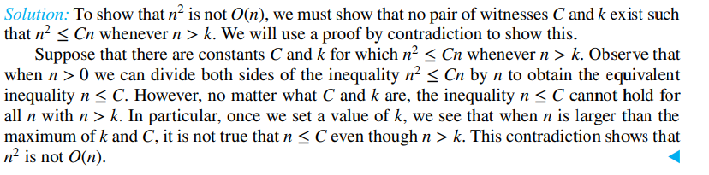
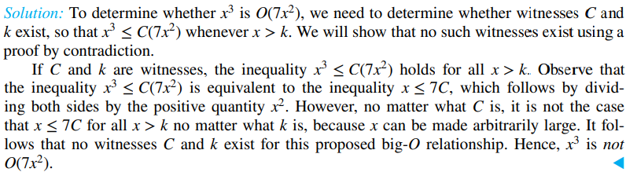
3.2 The Growth of Functions
Show that n2 is not O(n).
shows that 7x2 is O(x3). Is it also true that x3 is O(7x2)?

Slide 24
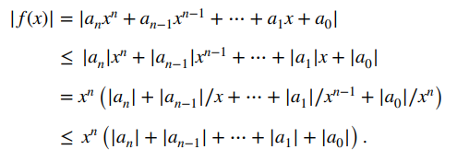
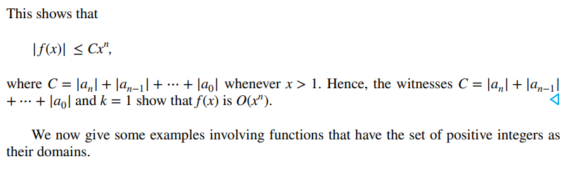
3.2.3 Big-O Estimates for Some Important Functions
Polynomials can often be used to estimate the growth of functions. Instead of analyzing the growth of polynomials each time they occur, we would like a result that can always be used to estimate the growth of a polynomial. Theorem 1 does this. It shows that the leading term of a polynomial dominates its growth by asserting that a polynomial of degree n or less is O(xn).
Using the triangle inequality, if x > 1 we have

Slide 25
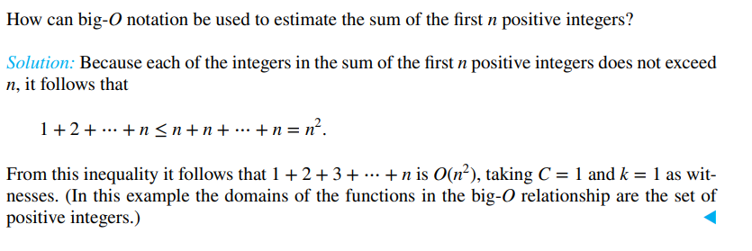
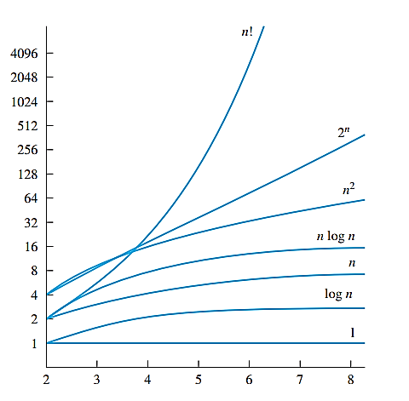
3.2.3 Big-O Estimates for Some Important Functions

Slide 26
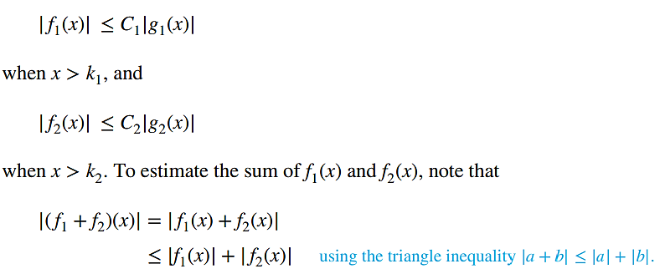
3.2.4 The Growth of Combinations of Functions
Many algorithms are made up of two or more separate subprocedures. The number of steps used by a computer to solve a problem with input of a specified size using such an algorithm is the sum of the number of steps used by these subprocedures. To give a big-O estimate for the number of steps needed, it is necessary to find big-O estimates for the number of steps used by each subprocedure and then combine these estimates. Big-O estimates of combinations of functions can be provided if care is taken when different big-O estimates are combined. In particular, it is often necessary to estimate the growth of the sum and the product of two functions. What can be said if big-O estimates for each of two functions are known? To see what sort of estimates hold for the sum and the product of two functions, suppose that f1(x) is O(g1(x)) and f2(x) is O(g2(x)). From the definition of big-O notation, there are constants C1, C2, k1, and k2 such that

Slide 27
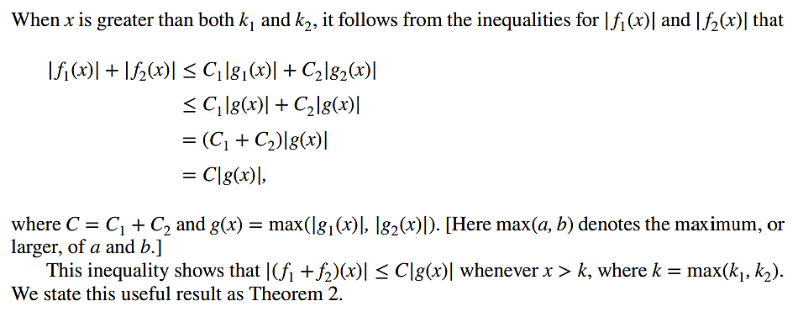
3.2.4 The Growth of Combinations of Functions

Slide 28
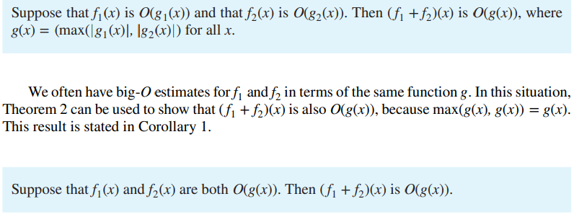
3.2.4 The Growth of Combinations of Functions

Slide 29
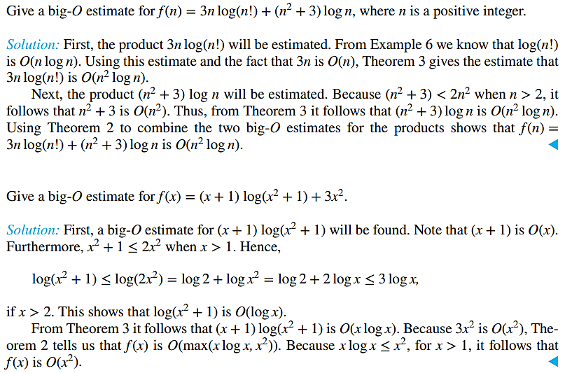
3.2.4 The Growth of Combinations of Functions, Examples

Slide 30
3.2 The Growth of Functions, Asymptotic Notations
Big O Omega Ω Theta θ

Slide 31
3.3 Complexity of Algorithms
Time complexity Space complexity
WORST-CASE, BEST-CASE AND AVERAGE-CASE COMPLEXITY

Slide 32


What is the worst-case complexity of the bubble sort in terms of the number of comparisons made?
The bubble sort described before Example 4 in Section 3.1 sorts a list by performing a sequence of passes through the list. During each pass the bubble sort successively compares adjacent elements, interchanging them if necessary. When the ith pass begins, the i − 1 largest elements are guaranteed to be in the correct positions. During this pass, n − i comparisons are used. Consequently, the total number of comparisons used by the bubble sort to order a list of n elements is;
What is the worst-case complexity of the insertion sort in terms of the number of comparisons made?
Solution: The insertion sort (described in Section 3.1) inserts the jth element into the correct position among the first j − 1 elements that have already been put into the correct order. It does this by using a linear search technique, successively comparing the jth element with successive terms until a term that is greater than or equal to it is found or it compares aj with itself and stops because aj is not less than itself. Consequently, in the worst case, j comparisons are required to insert the jth element into the correct position. Therefore, the total number of comparisons used by the insertion sort to sort a list of n elements is;

Slide 33
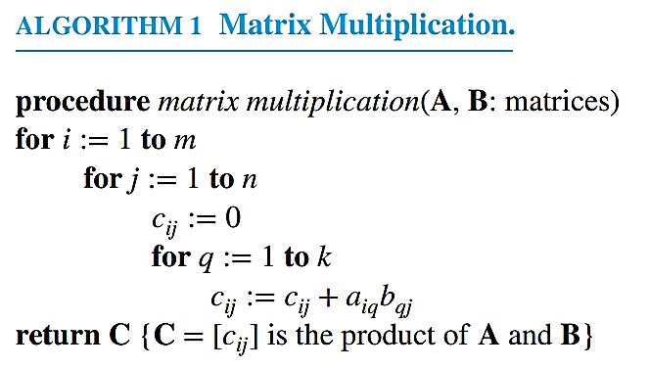
3.3.3 Complexity of Matrix Multiplication
The definition of the product of two matrices can be expressed as an algorithm for computing the product of two matrices. Suppose that C = [cij] is the m × n matrix that is the product of the m × k matrix A = [aij] and the k × n matrix B = [bij]. The algorithm based on the definition of the matrix product is expressed in pseudocode in Algorithm 1.
Solution: There are n2 entries in the product of A and B. To find each entry requires a total of n multiplications and n − 1 additions. Hence, a total of n3 multiplications and n2(n − 1) additions are used.

Slide 34
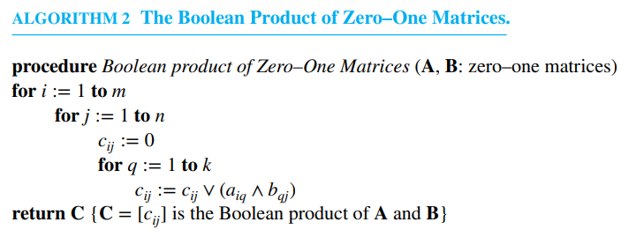
3.3.3 Complexity of Matrix Multiplication
The number of bit operations used to find the Boolean product of two n × n matrices can be easily determined.
EXAMPLE 8 How many bit operations are used to find A ⊙ B, where A and B are n × n zero–one matrices?
Solution: There are n2 entries in A ⊙ B. Using Algorithm 2, a total of n ORs and n ANDs are used to find an entry of A ⊙ B. Hence, 2n bit operations are used to find

Slide 35
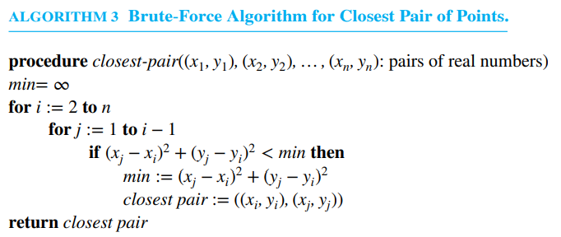
3.3.4 Algorithmic Paradigms
Greedy algorithms provide an example of an algorithmic paradigm.
BRUTE-FORCE ALGORITHMS Brute force is an important, and basic, algorithmic paradigm.

Slide 36
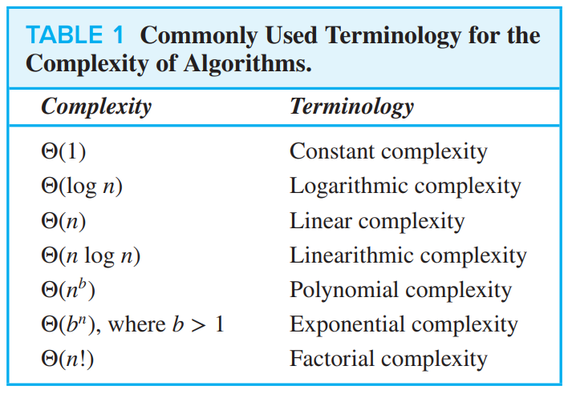
3.3.5 Understanding the Complexity of Algorithms

Slide 37
3.3.5 Understanding the Complexity of Algorithms
TRACTABILITY A problem that is solvable using an algorithm with polynomial (or better) worst-case complexity is called tractable, because the expectation is that the algorithm will produce the solution to the problem for reasonably sized input in a relatively short time. However, if the polynomial in the big-Θ estimate has high degree (such as degree 100) or if the coefficients are extremely large, the algorithm may take an extremely long time to solve the problem.
The situation is much worse for problems that cannot be solved using an algorithm with worst-case polynomial time complexity. Such problems are called intractable.
P versus NP problem

Slide 38
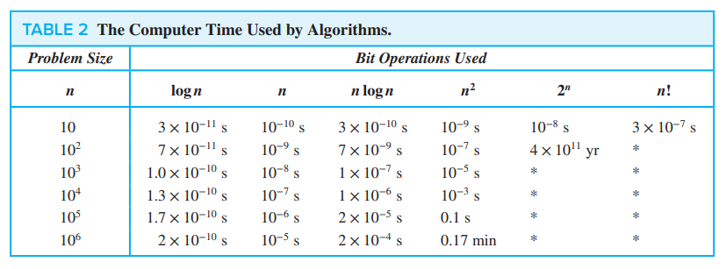
3.3.5 Understanding the Complexity of Algorithms

